Slide 1

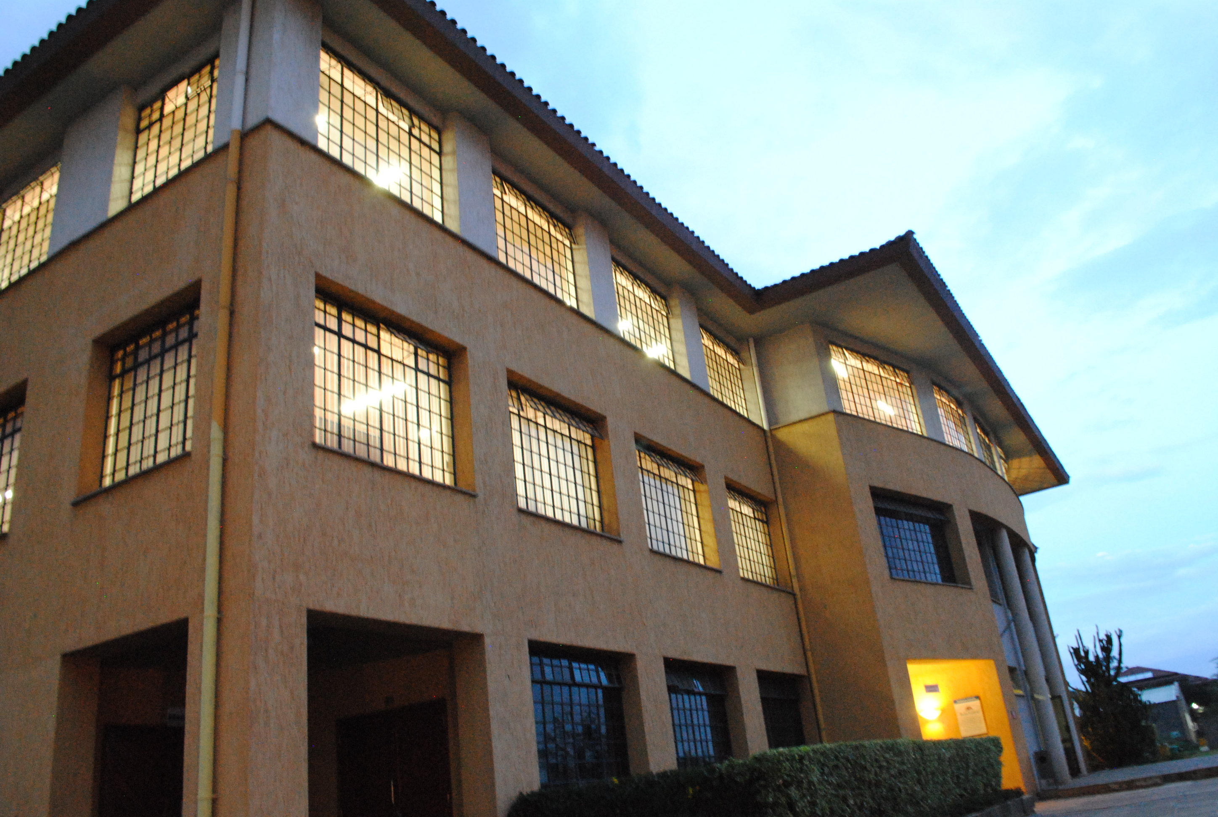

Moral Responsibility
Principles of Ethics

Slide 2
Overview
Responsibility for the consequences of a given act (Debeljuh, pp. 198-201)
Explain the degrees of responsibility for our own actions
Discuss how we may be responsible for the actions of others using relevant examples
Cooperation in evil (Debeljuh, pp. 206-214)
Distinguish material and formal cooperation in evil
Apply ethical guidelines for cooperation in evil to specific cases
Conscientious objection (Debeljuh, pp. 214-221)
Explain the meaning of conscientious objection
Discuss how to engage in conscientious objection in the professional context

Slide 3
Responsibility for consequences of our actions

Slide 4
Degrees of responsibility for own act + consequences
1. Fully responsible
Act + consequences: foreseen - known
Act + consequences: wanted - willed
4. Not responsible
Act + consequences: could not possibly be foreseen/involuntary
Invincible ignorance
2. Indirectly responsible
3. Partially responsible
Act + consequences: foreseen – known more or less
Act + consequences: not wanted – not willed
Act + consequences: difficult to foresee but could be foreseen
Vincible ignorance (can be overcome)

Slide 5
Am I responsible?
1. For my decision to use ChatGPT to do an individual assignment?
2. For knowingly using ChatGPT materials generated by another group member to complete a team assignment although I didn’t agree with using Chat GPT?
3. For using materials that I suspect a friend got from Chat GPT to complete a team assignment?
4. For using materials generated via ChatGPT by a friend for a group assignment before the existence of the app was public knowledge?

Slide 6
Poll: Managerial Responsibility
Is a manger responsible for the actions of her employees in the workplace?

Slide 7
Responsibility for actions of other people
Ways a manager could influence the actions of her employees in the workplace
Request
Persuasion
Example
Research online and give an example for each possibility in your professional context
#Request
#Persuasion
#Example

Slide 8
Cooperation in evil

Slide 9
Professional Context
When working with other people, we cooperate in greater or lesser ways with their actions
Business-people cooperate with various stakeholders: employees; clients; suppliers; shareholders
We share the moral responsibility for those actions to some extent
How far am I responsible for the actions of others?

Slide 10
Types of actions
Cooperation in good actions
My moral responsibility?
Cooperation in bad actions
My moral responsibility?
First Moral Principle:
Do good; avoid evil
What if I act well but this involves cooperating in a bad act done by someone else?

Slide 11
Cooperation in evil
Formal cooperation
I know about and agree with the evil action
Material cooperation
I do not know about / I know but do not agree with the evil action
Done by another person
Done by another person
Example: I agree with friend to use ChatGPT for group assignment
Example: I don’t know/do not agree with friend using ChatGPT for group assignment
Never ethically acceptable
Generally, not ethically acceptable

Slide 12
Conditions where cooperation in evil may be morally justifiable
Your cooperation [what you do] must be material cooperation [know + don’t agree] and not formal cooperation [know = agree]
The act you do, and the effect should be good
3. Your intention should be good
4. The good effect of your act should be the main effect and come before the bad effect
5. You need a proportionately serious reason to do a good act that may lead to a bad secondary effect

Slide 13
Proportionately serious reason
The importance, need for carrying out the good action, should be greater than the importance, seriousness of the bad effect
Good action
Bad effect

Slide 14
Groupwork
Design a case scenario to illustrate the difference between formal and material cooperation in evil, and how cooperation in evil may be morally acceptable

Slide 15
Conscientious objection

Slide 16
Think and respond
You have just started your first job. Two weeks later, your boss asks you to tell a guest that there are no rooms available at the resort, even though you know there are two free rooms.
What can you do?
What would you do?

Slide 17
The right to refuse
As a human person with a conscience, you have the right to refuse to do what your boss is asking
What is the technical term used to refer to this right to refuse to cooperate in something you understand is evil?

Slide 18
Conscientious Objection
Any form of resistance to an action required by a higher authority, based on what one’s conscience tells them they should do or not do
Source:
My judgement of conscience on whether or not to do an act
I am obliged by my nature to follow my conscience
WHY?

Slide 19
Conscientious Objection
Our society needs to develop an appreciation of and respect for every person’s right to conscientious objection
We should exercise it with courage when necessary

Slide 20
Think and respond
You have just started your first job. Two weeks later, your boss asks you to tell a guest that there are no rooms available at the resort, even though you know there are two free rooms.
How could you use the idea of conscientious objection to explain why you cannot do what your boss is asking?

Slide 21
Discuss in pairs
Identify 2 specific examples of cases where you might need to call on the right to conscientious objection in your future work context
Share on Zoom chat

